Slide 1
Django in the real world
Susan Ibach
Christopher Harrison

Slide 2
Security

Slide 3
Security concepts
Ensure data is only viewed by the people you intend to view it
Two main steps
Secure the data "on the wire"
Authenticate and authorize users

Slide 4
Secure Sockets Layer (SSL)

Slide 5
Securing the data on the wire
Secure Sockets Layer (SSL)
Seamless encryption
Uses a public key infrastructure (PKI)
SSL advantages
Encrypts the data
Validates the server
How do you know the server you're about to send data to is the server you think you're sending data to

Slide 6
How it works
Public certificate
Shared with the world
Certified by a Certificate Authority (CA) that everyone trusts
Verisign
Symantec
Thawte
Used when encrypting data sent to the certificate holder
Private key
Private
Used to decrypt data encrypted with the public key

Slide 7




How it works
Username: HockeyGeekGirl
Password: P@ssw0rd
Username: HockeyGeekGirl
Password: P@ssw0rd
S:DlkarewyaSDSDGH:ae
;aerayA$^Ahsr76sdffyt

Slide 8
Performance concerns
You may have heard enabling SSL degrades performance
Increased network traffic
Increased processor overhead
Don't you believe it!
Those are old concerns
It's not 1995 any longer
It's time to put away your parachute pants
SSL introduces a trivial amount of overhead, especially for the protection it provides
Consider enabling it on all applications
Whenever you ask a user for data
Anything behind an "authentication wall"
Further reading
Coding Horror: Should All Web Traffic Be Encrypted?

Slide 9
Enabling SSL
Obtain a certificate
Microsoft Azure provides a default certificate
Shared for all websites
Perfect for testing
Bad for production
Obtain a certificate from a CA
Documentation
Enable SSL in settings.py
Add SECURE_SSL_REDIRECT = True

Slide 10
Authentication vs Authorization

Slide 11
What's the difference?
Gaining access to a secure resource is a two step process
Authentication
Prove that you are who you say you are
Authorization
Show you have access to the desired resource

Slide 12
Modes of authentication
You authenticate by providing some form of an accepted credential
Just like in real life, the form can change

Slide 13
In real life
Flying domestically
Driver's license
Passport
Flying internationally
Passport

Slide 14
On the web
Username and password for that specific site
Another site's credential
Social media
Facebook
Twitter
Pinterest
Managed through Oauth

Slide 15
Django and authentication
Django provides the ability to securely store usernames and passwords
Extensible to support other modes of authentication
Several packages exist
Good starting point: Django Packages Authentication

Slide 16
Authentication in Django

Slide 17
Authentication is automatically enabled
In fact, we already used it when we created the admin site
We just need to provide the appropriate views

Slide 18
Creating a login page
We need two parameters
Username
Password
Basic steps
Authenticate the user
Ensure the username and password are correct
Log the user in
Associate the user with the current session
Redirect the user
Send the user to the desired resource

Slide 19
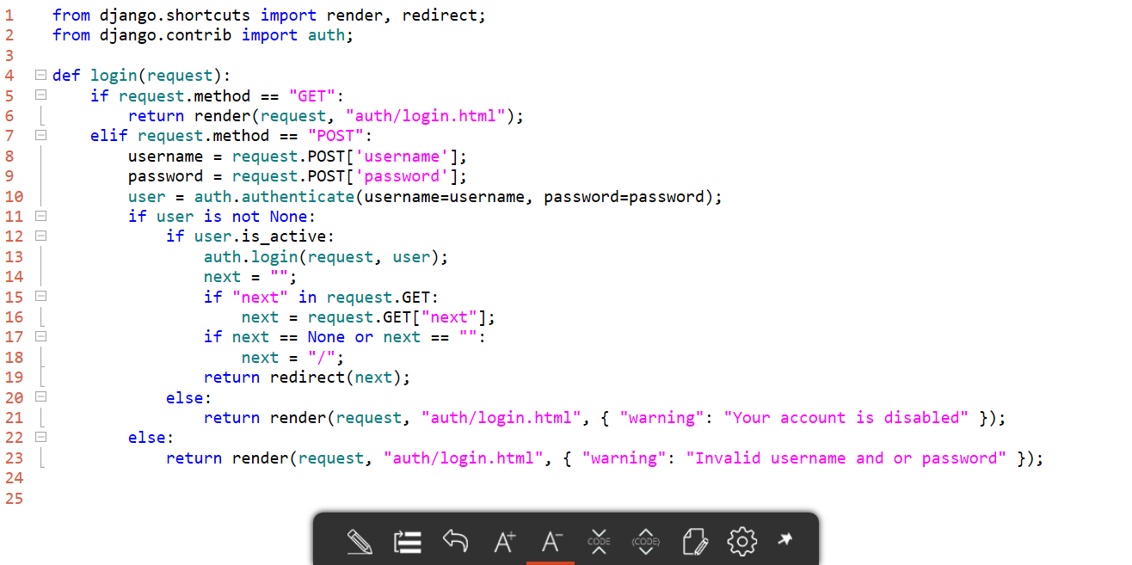
The view code

Slide 20
Create a login page

Slide 21
Accessing the current user

Slide 22
Access the current user by using user
Common properties
is_authenticated
is_staff
is_superuser
last_login
null if the user has never logged on

Slide 23
Logging out
Just like there's a login method...
There's a logout method
def logout(request):
auth.logout(request);
return redirect("/");

Slide 24
Adding logout and administration links

Slide 25
User registration

Slide 26
To create a user, we need
Required
username
password
email
Optional
first_name
last_name

Slide 27
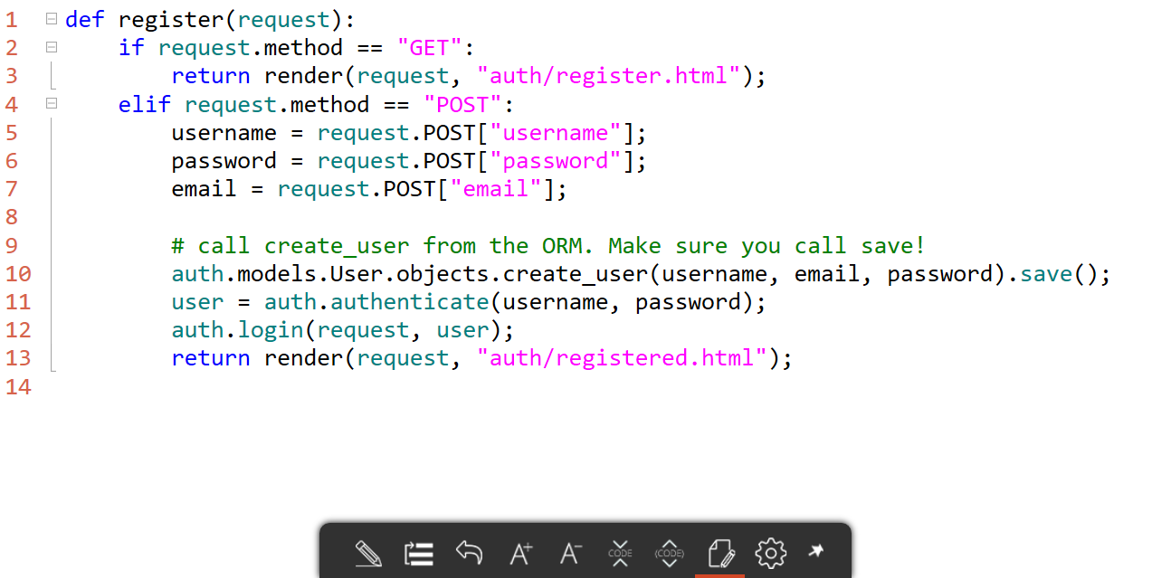
The code

Slide 28
Creating a registration page

Slide 29
Requiring authentication

Slide 30
If you just need to ensure the user is logged in
You could use user.is_authenticated...
But a better way to do it is to use the login_required decorator
@login_required
def submit_session(request):
return render(request, 'app/submit_session.html');

Slide 31
What does login_required do?
Checks if the user is logged on
If the user isn't logged on
Reroutes the user to the login page
Uses the LOGIN_URL setting
Defaults to /account/login/
Stores the requested page in the query string
Uses next as the key

Slide 32
Ensuring the user is logged on

